Slide 1
COOP 3150 Final Report
Henry Flowers
PricewaterhouseCoopers
Summer 2018

Slide 2
Table of Contents
Introduction
The Discussion
Work Term Description
Description of Department
Description of Responsibilities
The Interview Process
Personal Awareness
Conclusion
Appendix

Slide 3
Introduction
Objective of this report:
Bring awareness to opportunities at PwC
Help with applications to PwC
Disclaimer: The views expressed in this report are my own, and are not a reflection of PwC.

Slide 4
The Discussion
Work Term Description
Description of the Assurance practice
Description of Responsibilities
Disclaimer: The views expressed in this report are my own, and are not the opinions of PwC.

Slide 5
Work Term Description
Description of the Organization
PricewaterhouseCoopers (“PwC”) is a professional services firm that has more than 6,700 partners and staff in locations from coast to coast in Canada.
PwC provide industry focused professional services including audit and assurance, risk assurance, tax, deals and consulting in areas such as cybersecurity and privacy, human resources, digital transformation and forensics. The firm help resolve complex issues and identify opportunities for public, private and government clients.
As part of a global network of over 236,000 people in 158 countries, PwC helps organizations and individuals create the impact they’re looking for, by delivering the best of our collective thinking, experience and solutions to build public trust and enhance value for our people, clients and communities (PwC, 2018).

Slide 6
Work Term Description
Description of the Assurance Practice
I currently work in the Audit and Assurance practice. Our team conducts audits and reviews of organizations to provide reasonable assurance that the information they are presenting is valid.
PwC is renowned for its audit practice, particularly in audit innovation through use of in-house developed software and, more recently, artificial intelligence.
The major activities of the department include public company audits, private company audits/reviews, advising on risk management, and accounting advisory services for technical accounting issues.
The structure of a typical audit engagement is a Partner (Engagement Leader), Senior Manager, Manager, Senior Associate, Experienced Associate, and New Associate/Summer Associate.

Slide 7
Work Term Description
Description of your Responsibilities
My first engagement was with the Pension Centre of Excellence, where I worked on pension audits for several different companies simultaneously.
My tasks included reviewing financial statements for mathematical and logical accuracy. I also aided in preparing disclosure notes for clients.

Slide 8
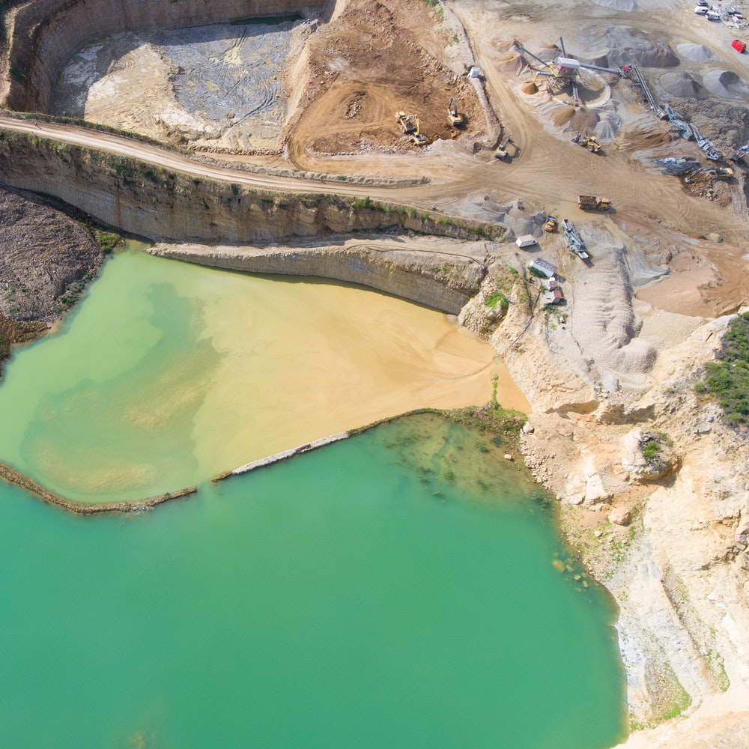
Work Term Description
Description of your Responsibilities
Second engagement was Audit Planning for mining and energy companies through the Summer Student Audit & Planning Centre of Excellence (“SSPACE”). I planned audits through Aura, PwC’s audit ERP system. Planning included researching the company, explaining audit risks, determining materiality, and establishing the scope of financial items to audit.

Slide 9
Work Term Description
Description of your Responsibilities
My third engagement was an Interim Audit for a large construction company. On this engagement I was tasked with analyzing samples of expenses, payroll, contracts, etc. I was also responsible for vouching account balances through inquiry. One task which stood out was auditing percentage of completion for projects which required going to project sites and taking pictures.

Slide 10
Work Term Description
Description of your Responsibilities
My fourth engagement was a first-year audit for a quantum computing company. My tasked included researching the company for planning purposes, testing samples, and vouching for account balances.

Slide 11
The Interview Process ← USE THIS LINK FOR MORE TIPS!!
Online Application
Online Assessment
On-demand Video Interview
In-person Live Interview
Disclaimer: The views expressed in this report are my own, and are not the opinions of PwC.

Slide 12
The Interview Process
Required:
Resume or CACCEE form
Unofficial Transcript
No Cover Letter
Insider Note:
Resume is not reviewed until In-person interview.
Transcript is not reviewed unless needed for tie-breaker in final round.
Only In-person interviewer will know what school you come from.
Online Application:
PwC is innovating their hiring process by digitalizing applications.

Slide 13
The Interview Process
Online Assessment:
PwC is introducing online assessments which reduce bias and provide immediate feedback.
Required (48hrs to Complete):
Logical Reasoning (20 min)
Numerical Reasoning (20 min)
Work Style Preference (No time limit)
Insider Note:
Use as many online resources as you can to review for logical and numerical tests.
Use the PwC Professional Framework qualities as guidance for Work Style Preference.

Slide 14
The Interview Process
On-demand Video Interview:
PwC is introducing online video interviews that enable you to interview where you want and when you want.
Required (48hrs to Complete):
3-4 Question Interview (Email invite)
Audio-visual enabled device
30 sec review question then 2 min or less per question response (no re-recording)
Insider Note:
Practice with Sample Questions, and search for sample PwC questions online
Reviewed by multiple PwC senior staff
Use the PwC Professional Framework (Appendix A) qualities as guidance for responses.

Slide 15
The Interview Process
Required (48hrs to Complete):
Behavioural Question Interview (Email invite)
Prepare minimum of 3 questions (best to actively listen and frame questions based off interview discussions)
Insider Note:
Request to learn who your interviewer is and research them on LinkedIn
Interviewers tend to be very approachable and easy going
Use the PwC Professional Framework (Appendix A) qualities as guidance for responses.
In-person Live Interview:
PwC’s final round is a live interview. Technology or Consulting roles have an additional group case exercise.

Slide 16
Personal Awareness
Main Learning Objective
Effect on Career Objective
Motivators
Relevant Academic Programs
Disclaimer: The views expressed in this report are my own, and are not the opinions of PwC.

Slide 17
Personal Awareness
Main Learning Objectives:
Build Accounting Knowledge
Develop Professional Network
Learn about Lines of Service
Build Accounting Knowledge:
Met through experiences in engagements, particularly in Planning where I had to develop audit strategies and define testing requirements.
Develop Professional Network/Learn about LoS
Met with Managers and Partners from varying industries such as Cannabis, Forestry, Technology, Mining. Also, met members of different service lines including Tax, Deals, and Risk Assurance.

Slide 18
Personal Awareness
Effect on Career Objectives:
Pathways:
As a result of my coop experiences, I’ve come to find Pathways, a rotational program for Assurance and Risk Assurance, as the most appealing. I got word from multiple partners and seniors that this program is indicative of the role most associates will have in the future.
Deals:
After holding discussions with members of the Deals team, I’ve developed an interesting in joining the Transaction Advisory subgroup of the deals team after I’ve obtained my CPA. It would be an interview process and would align me with pursuing my CBV or CFA designation.

Slide 19
Personal Awareness
Motivation:
Challenging work
Interesting Team
Challenging Work:
The most fun I’ve had is during engagements like Planning and First-Year Audits where I have to really think through my actions and develop methodologies.
Interesting Team:
I’ve found team dynamic to also be a big motivator. When I’m on a team with people that have humorous and keen personalities, I tend to enjoy those atmospheres the most.

Slide 20
Personal Awareness
ACCT 3444 (Auditing)
Many relevant concepts such as assertions, materiality, and controls.
ACCT 4120 (Financial Statement Presentation and Analysis)
Great for CFE prep, as well as realistic application of accounting standards. Important to understand CGAAP, ASPE, IFRS, etc.
CBSY 2306 (Accounting Systems and Advanced Reporting Applications)
Understanding of Excel functions and business processes through the lens of an accounting software is highly relevant.
Relevant Academic Programs:
My top 3 are -
ACCT 3444
ACCT 4120
CBSY 2306

Slide 21
Conclusion
In conclusion, I would strongly recommend a Coop with PwC. The retention rate for interns is extremely high. The firm structure enables a lot of opportunities for professional development, and over a couple of years will form you into strong management material. Take advantage of the international travel opportunities through secondments and the many global clients.
There’s a wide range of appeals. Interested more in mid-size? PwC MySolutions team provides a full range of non-audit assurance, advisory, and taxation services to clients, primarily owner-managed and family businesses. It’s a mid-size experience while still having access to the firm’s resources and network.

Slide 22
Appendices

Slide 23
Appendix A: PwC Professionals Framework
Click on this link for more info!

Slide 24
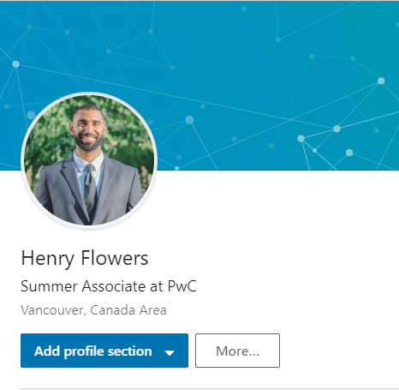
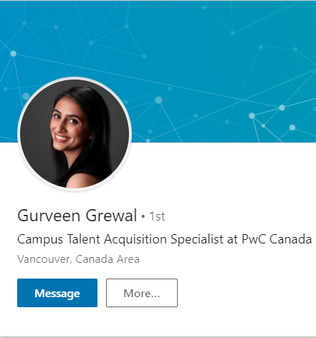
Appendix B: Key PwC Contacts for KPU
Henry Flowers
Campus Ambassador 2017-’18
Gurveen Grewal
Campus Talent Acquisition Specialist (Western Region)

