Slide 1
Integrating hogs in a cover-vegetable rotation for healthy soils
February, 22, 2022 – WWSA/CWSS annual conference
Leah Sandler and Micheal Robinson, Research Associates
The Institute for Sustainable Food Systems
Notes:
ISFS is an applied research and extension unit at KPU that investigates and supports regional food systems as key elements of sustainable communities.
potential of regional food systems in terms of agriculture and food, economics, community health, policy, and environmental integrity

Slide 2
Outline
Research conception and objectives
Materials and methods
Results and conclusions

Slide 3
Research Conception
Many market crop farmers routinely put some growing acreage into cover crops - crop rotation plan
Up to 3 times per year (spring, summer and fall)
add SOM
enhance fertility
control weeds, diseases
Practice of tilling cover crops to terminate growth negatively impacts soil structure and biological activity
Notes:
Plant, grow, turn under cover crop,

Slide 4
Research Conception
Specific to our area (Fraser Delta) - effects are exacerbated in clay textured soils
Management may require machinery, implements not available to smaller scale, start up market crop farmers

Slide 5
Research Objectives
Find regenerative ways to manage cover crops and on-farm fertility while reducing reliance on extensive use of tractor tillage
Determine the potential benefits from integration of hogs into vegetable production
Investigate the impacts of integrating hog strip grazing in a vegetable –cover crop rotation system on soil quality, nutrient life cycle, weed management, subsequent vegetable harvest
Notes:
merits of using hogs as part of a sustainable crop rotation, nutrient cycling and land management system for market crop farming. When managed well, an integrated hog and crop system can reduce labour and revitalize neglected and diminished fields rapidly, getting them into a productive state while eliminating the need for expensive machinery, hence making this a particularly viable option for new entrant and smaller scale farmers

Slide 6

Materials and methods
Tsawwassen, BC
RCBD, 4 reps
Two treatments: Grazing (pigs) and Tillage
Main-plot: 30 ft x 230 ft
Subplots: 6 per main-plot for grazing (30x38 ft)

Slide 7
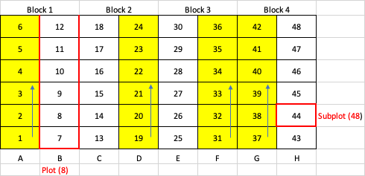
Materials and methods

Slide 8
Materials and methods
Hogs were moved through subplots as cover crop was eaten down, soil remained covered by at least 30%
Moved through series of subplots two times
Approx. every 7 days
Notes:
More like 15days first time around
using the conservation tillage principle that

Slide 9
Materials and methods
3 cover crop seedings
Spring – oats, ladino clover, field pea
Summer – sudex-sudan, buckwheat, ladino clover
Fall – fall rye, vetch
In grazing, hand spread sublot 24 hours before moving pigs, augmented 45% to account for consumption
In tillage, mechanically turned in then hand spread
Notes:
In sping -after 60 days of growth

Slide 10
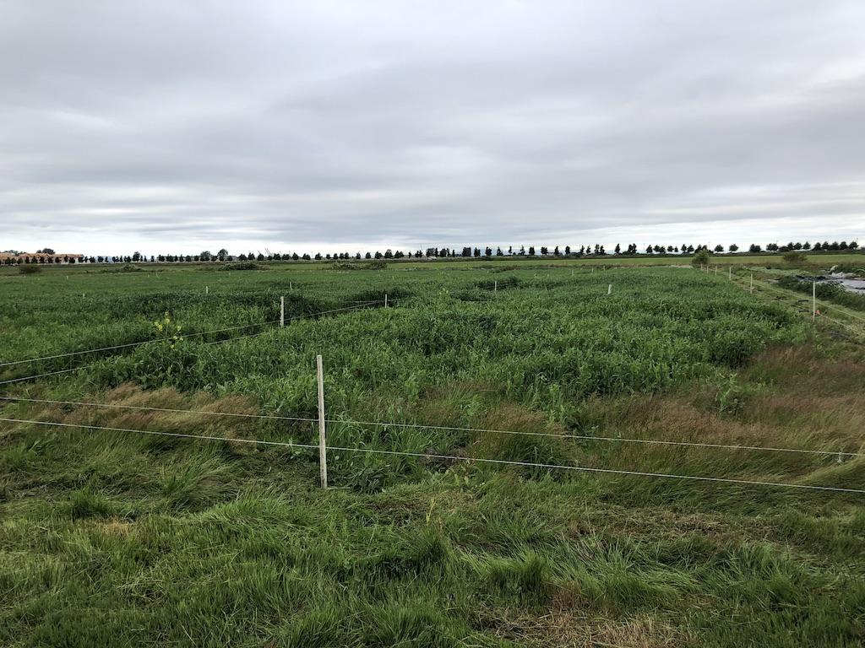
July 2 - fencing into spring cover
Notes:
May 13 planted

Slide 11
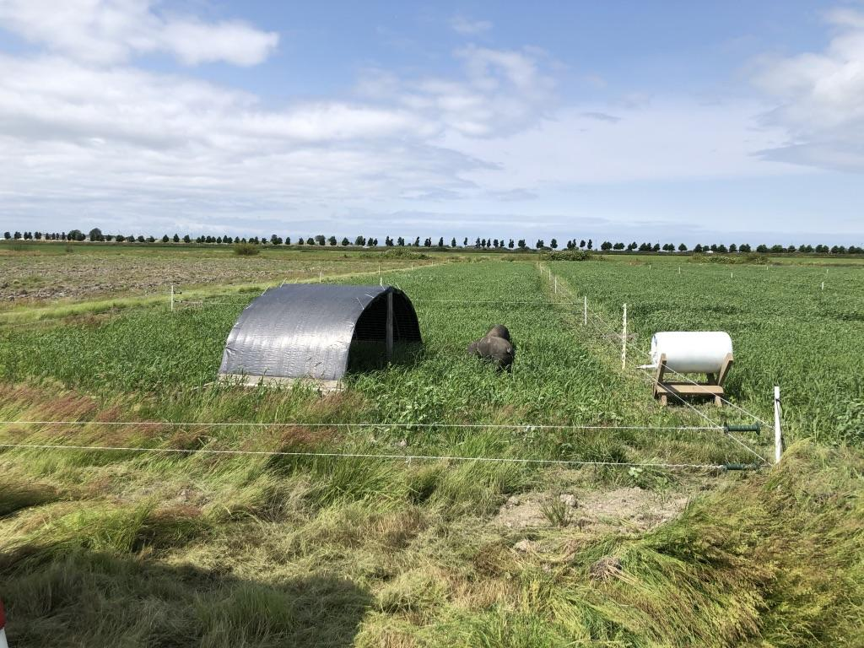
July 2 – pigs into main plots

Slide 12
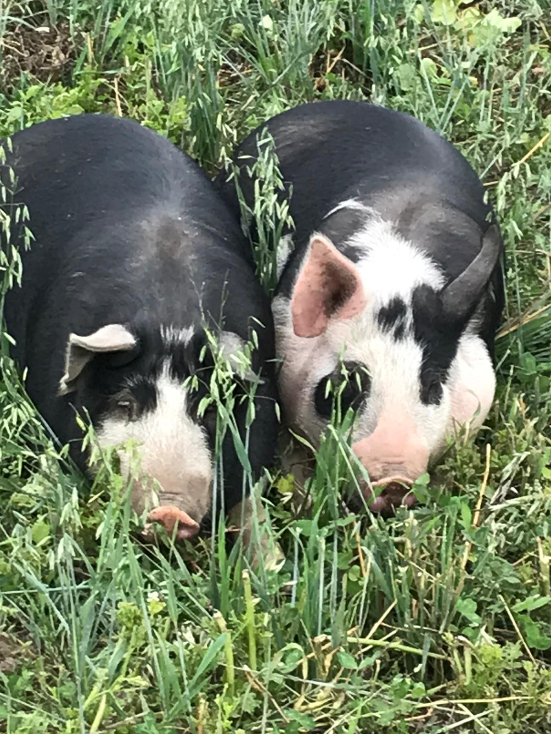

Slide 13
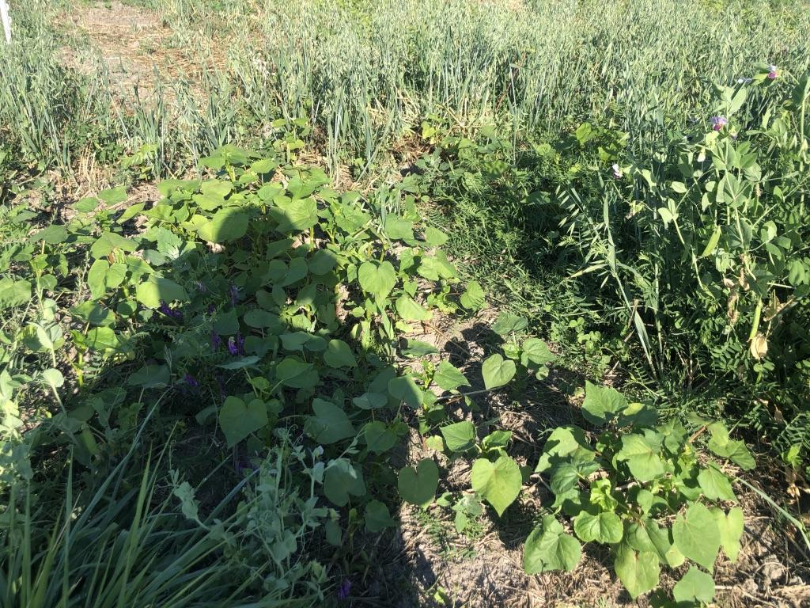
Aug. 17 – summer cover crop

Slide 14
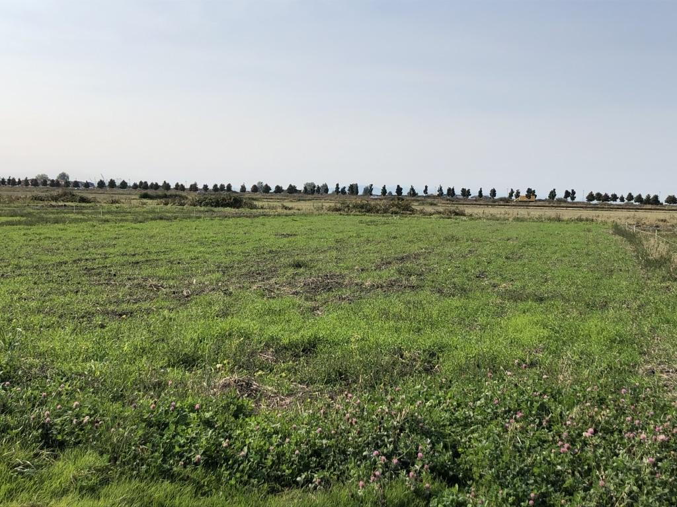
Sept. 30 - tillage plots

Slide 15
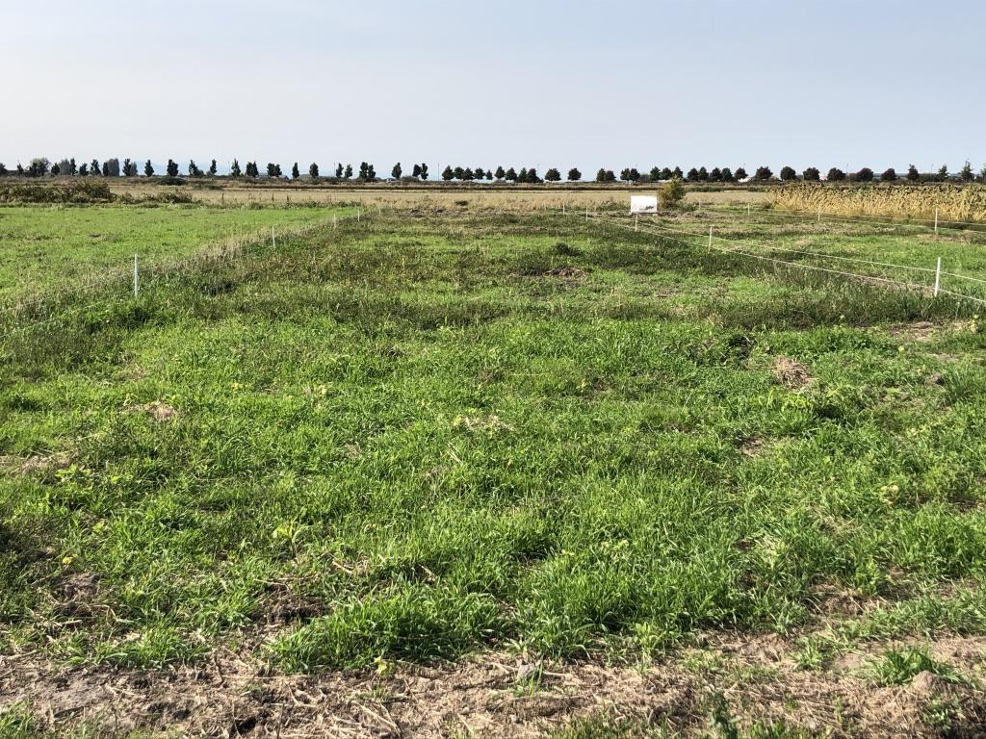
Sept. 30 - hog plots

Slide 16
Materials and methods
Vegetables following hogs – butternut squash, sweet corn
2 and 6 rows per main plot
Sampling
Weed percent cover, number, type throughout crop establishment
Yield and crop performance
ANOVA
Fixed effects: treatment, year; Random effects: block
p ≤ 0.05

Slide 17
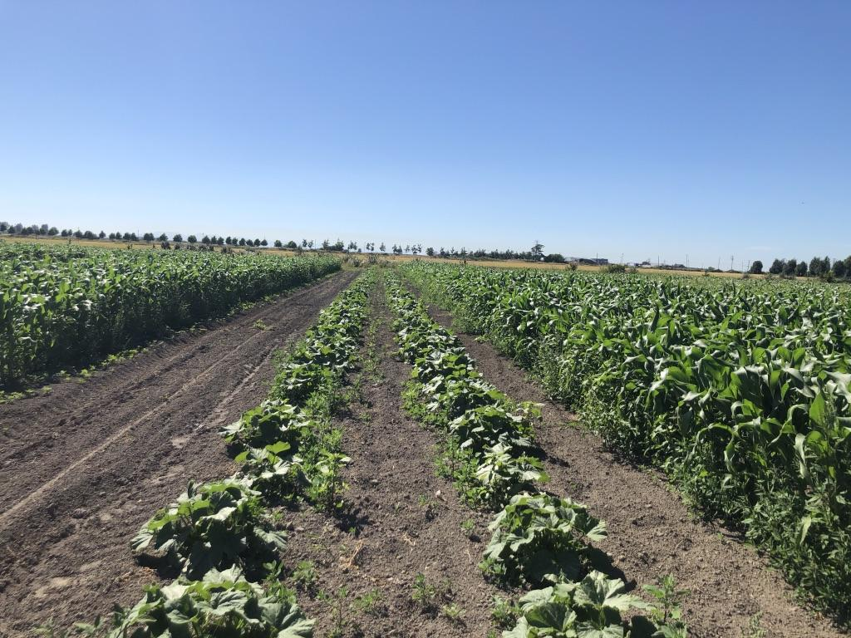
July 29 - squash and corn

Slide 18
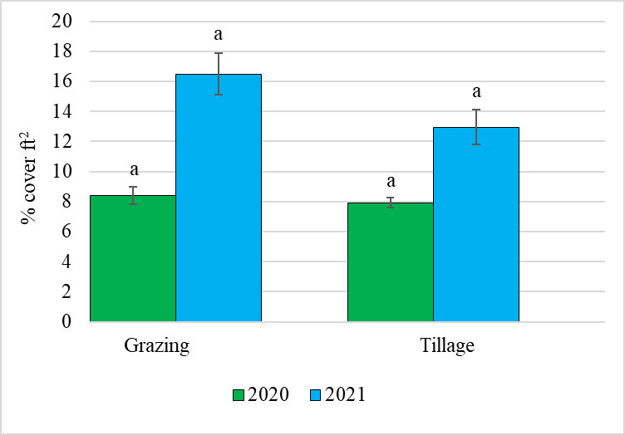
Results
ANOVA: treatment, year, treatment*year

Slide 19
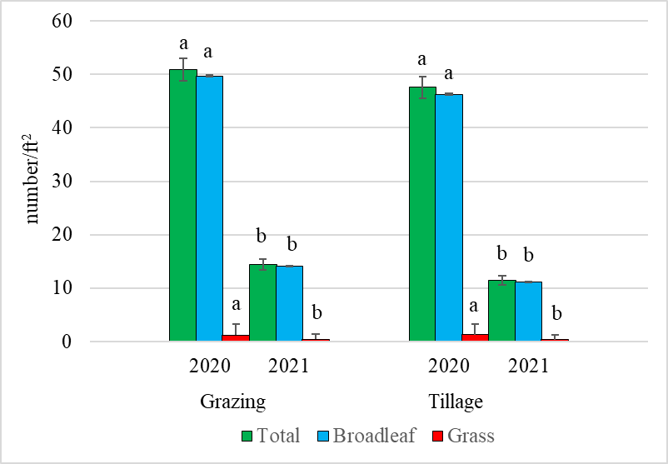
Results
ANOVA: treatment, year, treatment*year

Slide 20
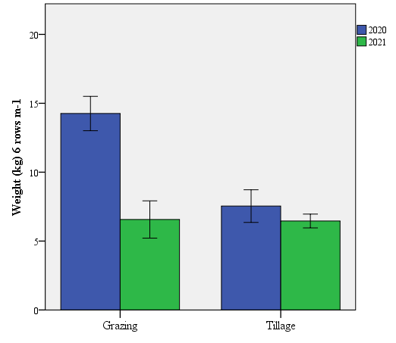
a
b
b
b
ANOVA: treatment, year, treatment*year

Slide 21
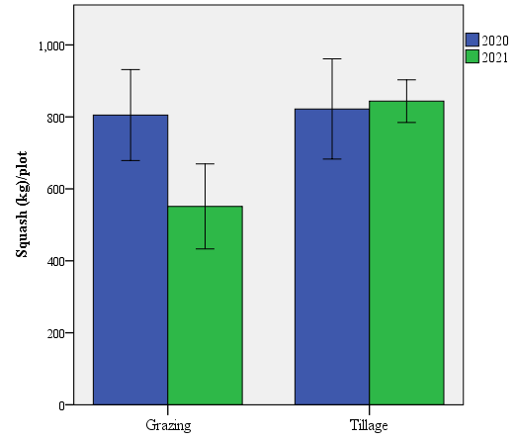
a
a
a
a
ANOVA: treatment, year, treatment*year

Slide 22
Conclusions
No statistical treatment differences in weeds
Although tillage did have lower numbers
Year was significant in number of weeds
Treatment*year significant in corn yields
2020 yields were larger than 2021 overall
No differences in squash yield

Slide 23
Conclusions
Successful hog rotation system- low labour and cost
Grazing didn’t impact weed seed bank to the next crop
Need more time
Corn is a heavy N user, perhaps see difference in yield due to hog nutrient input
Anecdotally, were visual differences

Slide 24




Acknowledgements
Tsawwassen First Nation
Micheal Robinson
Kent Mullinix
Sean Smukler
Franco Lopez

Slide 25
Questions or comments:
Questions or comments: leah.sandler@kpu.ca
314-598-6217

