Slide 1
FACULTY OF ARTS:
DECLARATION MONTH

Slide 2



Why declare your bachelor of arts?
When you declare your major, you will have access to department specific scholarships which means more scholarship opportunities!

Slide 3
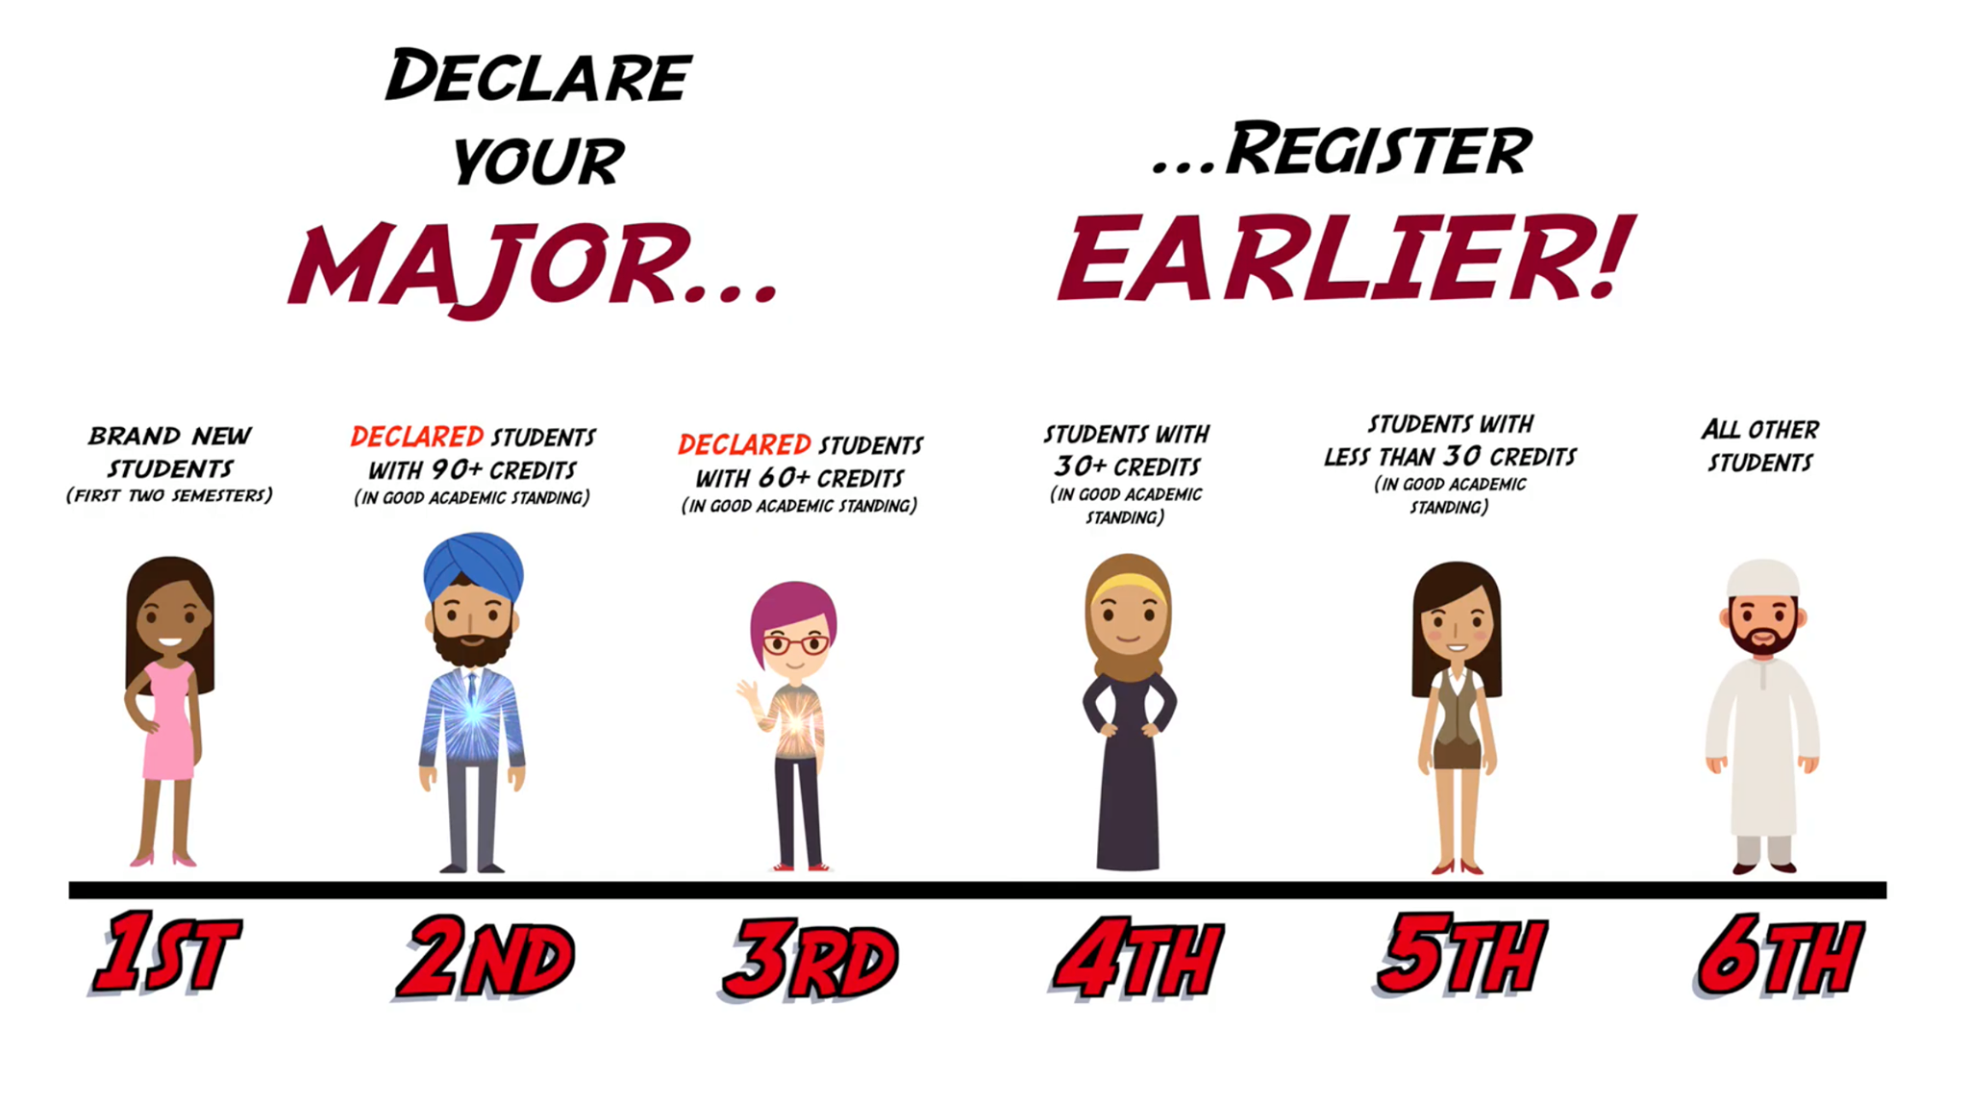
WHY DECLARE YOUR BACHELOR OF ARTS?
2. Students who declare their major receive earlier registration times.
Notes:
Questions will need to be published by a producer and will not be visible to the public
Ask for guests to introduce themselves (not program – that’s later)
Make random comments about responses/interesting introductions

Slide 4



Why declare your bachelor of arts?
3. Create a community!
  When you declare your Major, you will have access to student clubs, department events, and more.
To learn more, visit kpu.ca/arts/declare
Notes:
Poly-What? Slide:
Insert slide stating” Canada’s only polytechnic university” → “it’s closer than you think” campaign?
Use whiteboard video?? Would we want two videos back-to-back though?

