Slide 1
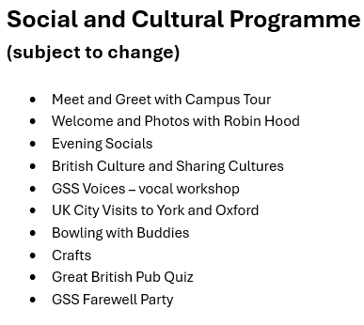
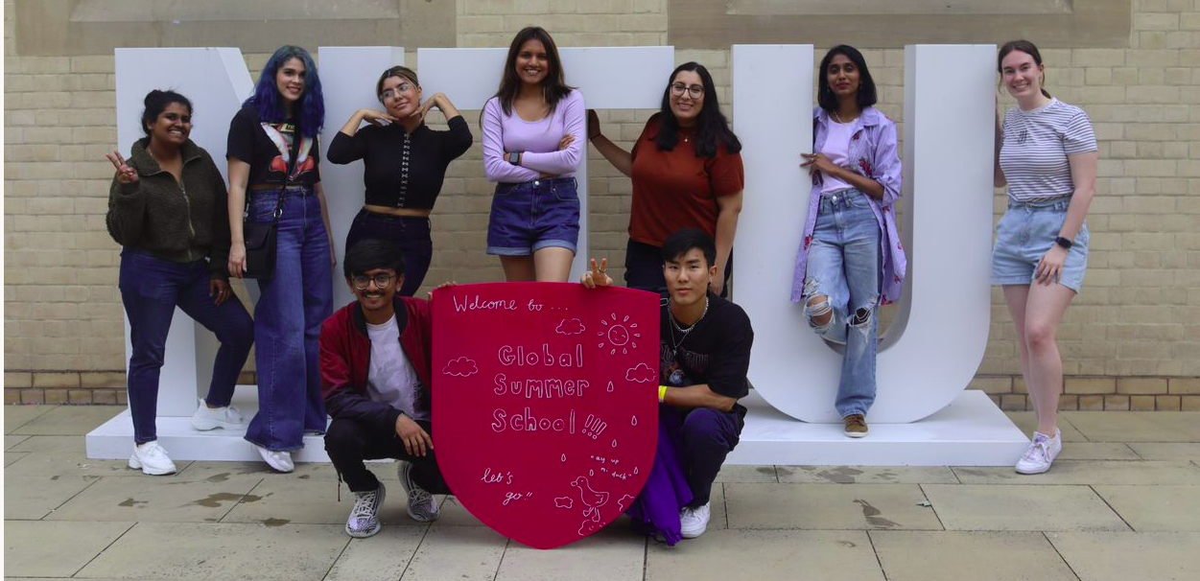
Courses (subject to change) – 10 UK credit points
NTU GLOBAL SUMMER SCHOOL – 7 JULY TO 1 AUGUST 2025
7 – 18 July (2 weeks) | 21 July – 1 August (2 weeks)
Astronomy, Rocketry, and Space Science | Architectural History and Drawing the City
Cybercrime and Cyber-Security | Becoming an Entrepreneurial Citizen
Design and Innovation in Business | Crime Investigation
English Language and Culture | Design History in a Global Context
Financial Markets and Investments | Digital Marketing and Communication for the Creative Industries
Global Fashion Branding & Design | English Language and Culture
Language, Communication and Playwriting | Homelessness and Substance Misuse: multi-discipline interventions
Music Production | Media and Crime
Neurodiversity from Brain to Behaviour | Smart Agriculture and Future Crops
Podcast Production: from brainwave to airwave | Wellbeing Masterclass
Photography and Heritage
Serious and Organised Crime
www.ntu.ac.uk/globalsummer

