Slide 1



Analysis of the Polycentric Governance of Local Food in Canada
Brent Swallow¹, Stephanie Budynski¹, and Mary Beckie²
¹ Department of Resource Economics and Environmental Sociology, University of Alberta, Edmonton, Alberta
² Faculty of Extension, University of Alberta, Edmonton, Alberta
Presentation to the Place-Based Food Systems Conference, August 9-10, 2018, Richmond, British Columbia

Slide 2
Globalization
Concentration in agri-food business
Global finance ownership
Obesity & diet-related health problems
Environmental burden of production
“Distancing” between producers and consumers
International agreements, national policies, international competitiveness
Introduction (1/4)
Source: Jennifer Clapp, 2018.

Slide 3
Globalization
Localization
Concentration in agri-food business
Global finance ownership
Obesity & diet-related health
Environmental burden of production
“Distancing” between producers and consumers
International agreements, national policies, international competitiveness
Local food perceived to have multiple benefits
Place-based foods perceived to be more authentic
Local governments more involved, multiple objectives (eg. Milan Urban Food Pact; Edmonton’s Fresh Strategy)
Introduction (2/4)

Slide 4
Canadian Policy Context
Heavy dependence on agricultural exports and food imports
Concentration of agri-food business & land ownership (e.g Sobey’s / Safeway; Nutrien)
Decline of food processing sector
Vulnerability to US, greater importance of bilateral trade agreements
Constitution indicates agriculture as a shared federal / provincial responsibility
Increasing interest in local and placed-based foods and increasing role of municipalities
Introduction (3/4)

Slide 5
Objectives
Articulate and apply a poly-centric governance approach to analysis of food policy
Summarize results of first analysis for Canada
Introduction (4/4)

Slide 6
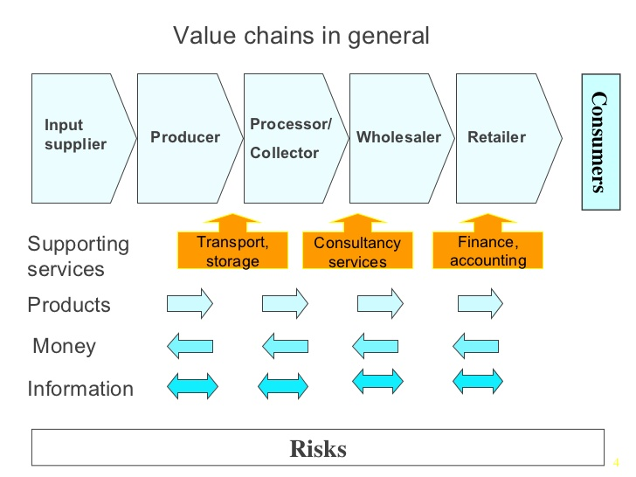
Value Chain Framework
Poly-centric governance approach (1/3)

Slide 7
Overlapping levels of influence
International
National
Provincial
Municipal
Poly-centric governance approach (2/3)

Slide 8
Qualitative public policy analysis
Identify problem context (policy determinants of local and place-based foods).
Identify relevant levels of public policy & governance (municipal, provincial, federal).
Identify public policy objectives at each level.
Purposively select and analyze cases for a range of specific local contexts.
Summarize and analyze policies in case studies, emphasis on contradictions, contrasts, gaps.
6. Generalize results
Breitkreuz, R., Stanton, C. J., Brady, N., Pattison‐Williams, J., King, E. D., Mishra, C., & Swallow, B. (2017). The Mahatma Gandhi National Rural Employment Guarantee Scheme: A Policy Solution to Rural Poverty in India? Development Policy Review 35(3): 397-417.
Poly-centric governance approach (3/3)

Slide 9
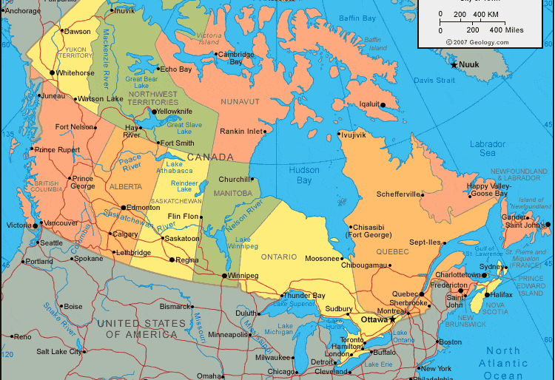

Slide 10
Table 1: 11 Objectives for Canada’s agri-food system
 | Policy objective | Justification / Inspiration
1 | Strengthening food security and affordability for vulnerable populations | UN Rappateur Report; House of Commons Standing Committee Report; Urban Food Charters
2 | Encouraging healthy eating and good nutrition | Nordic Food Policy; Health Canada’s Healthy Food Strategy; Urban Food Charters
3 | Ensuring safe food and public trust in the food system | Safe Food for Canadians Act (2015); food fraud, traceability, and certification regulations; animal welfare issues in the House of Commons Standing Committee Report.
4 | Protecting Canadian consumer markets for supply by Canadian producers | Supply Management System for dairy, poultry, eggs; Fed-Prov Business Risk Management Programs;
5 | Increasing profitability and competitiveness of food producers & processors | Barton Reports; New farm and food business development programs; Canadian Agricultural Partnership
6 | Promoting sale into international export markets | Multi-lateral and bilateral trade agreements; Baron reports.
7 | Enhancing innovation | Incubators for new food products . Barton reports.
8 | Maintaining healthy landscapes, reducing environmental impact | Wetland conservation programs; pesticide regulations; support for beneficial management practices
9 | Sustaining and protecting land and natural resources | Farmland preservation trusts and policies; municipal zoning regulations; urban food charters
10 | Encouraging a vibrant local food system, culture and rural societies | Urban food charters; procurement policies of MASH Institutions (municipalities, academic institutions, school boards, healthcare providers); Senate Report on how to keep farmland in the hands of Canadian farmers.
11 | Reducing food waste | Nordic Food Policy; urban food charters
Results (1/6)

Slide 11
Areas of conflict between policy objectives
Supply management system for poultry, eggs, dairy
  – protects Canadian market for medium-large scale producers and processors
  -- tradeoffs with food affordability;
  specialized production for local markets;
  competitiveness in international markets
Restrictions on inter-provincial trade to protect local markets
  Eg. Differential provincial support for craft beer
  Local food safety standards for local sales at farmers markets
  Supports small to medium scale, may limit larger scale and exports
Results (2/6)

Slide 12


Areas needing policy harmonization
Provincial innovation funds are small and diffuse.
  Local priorities limit national cohesion in many fields of innovation (eg Barton / McKinsey reports)
  Protein Industries Supercluster, using plant genomics and novel processing technology to increase value of key Canadian crops, including canola, wheat and pulses
Results (3/6)

Slide 13
Areas of contrast between jurisdictions
Farmland preservation (BC ALR, Ontario Greenbelt, Nova Scotia community easements; devolved to municipalities in Alberta)
Support for small & medium scale processors focused on local markets (innovation, start-up, compliance with food safety regulations)
Urban agriculture as a policy problem or opportunity (contrast in policy attention among Alberta municipalities)
Promotion of local food cultures
Food sourcing by MASH organizations (municipalities, academic organizations, schools, hospitals)
Results (4/6)

Slide 14
Areas of Policy Gap
Healthy eating and diet-related disease management (especially compared to the Nordic policy environment)
The never-ending war for Canada’s Food Guide (MacLean’s, It’s been 10 years since the last revision, and it took two years and 20,000 submissions to overhaul it. And almost nobody will agree with the result.
by Murad Hemmadi Apr 9, 2018
Food waste
  No national policy, mostly addressed by municipal governments
Comprehensive national food policy (in progress)
Results (5/6)

Slide 15
Areas of Policy Gap
Food security and food rights
  UN Rapporteur on the right to food
  First Nations and coordinating federal and provincial responses
  NGOs and food corporations filling much of the gap through food banks
  No national food policy
Results (6/6)

Slide 16
Conclusions
Qualitative policy approach as a complement to quantitative and indepth studies
2. Canadian policy approach is fragmented, with numerous gaps and contradictions.
3. Policy advocacy tends to be either / or
4. Possibility of a Nordic approach?
Supported by leaders at multiple levels
Led by nutrition & food security objectives
Stressing constructive consultation, public-private-NGO partnerships
Acknowledging advantages of specific policy tools
Conclusions (1/1)

