Slide 1
Assessment Session 1 Introduction to Assessment Aligning Assessment with Learning Outcomes
August, 2014
Diane Salter, Vice Provost Teaching and Learning

Slide 2
Your feedback to pre-session questions:
What are your main reasons for attending these sessions?
Do you have specific questions about assessment that you would like to ask?
Are you attending one or both workshops?
Is there anything else that you would like me to know before the sessions?

Slide 3
Desired Learning Outcomes
At the end of this workshop participants will be able to:
Give examples of a variety of ways to assess student learning
Consider ‘formative’ and ‘summative’ assessment
Apply the outcomes based approach to consider how assessments can be chosen to align with learning outcomes
Discuss the purposes of assessment
Design appropriate assessment for your course

Slide 4
Why do we Assess???
List as many reasons that you can think of to describe
the purpose of assessment.

Slide 5
Why do we Assess???
Learning
Certification
Quality Assurance

Slide 6
Learning
To:
Motivate students
Diagnose strengths and weaknesses
Consolidate work done to date
Help students develop a capacity for self-assessment
Establish the level of achievement at the end of a unit of study

Slide 7
Certification
To:
Establish the level of achievement at the end of a program of study
Pass or fail a student
Grade or rank a student
Underwrite a ‘license to practise’
Demonstrate conformity with external regulations (e.g. professional bodies)
select for employment, further education, etc.
Predict future employment

Slide 8
Quality Assurance
To:
Assess the extent to which a program’s aims have been achieved
Judge the effectiveness of the learning environment
Provide feedback to teachers regarding their personal effectiveness
Monitor levels of achievement over time
Assure interested parties that the program or unit of study is at an appropriate standard
Protect the relevant profession
Protect the public

Slide 9
Please consider the exercise in your binder
‘Types of Assessments’
PART A
PART B

Slide 10
Why feedback?
Students need feedback in order to:
understand how the grade is given
find out where they have made mistakes and how they can improve next time
gain a sense of progression
Other??

Slide 11
When are assessments used?
Formative
Summative

Slide 12
Why Formative Feedback?
Faculty often see assessment as a
Students need formative feedback to help
enhance their learning
Faculty need formative feedback from students to monitor misconceptions
Other??

Slide 13
Feedback is helpful to students when it:
is provided in a timely manner
includes both specific comments (relevant to the assignment being reviewed) and general suggestions (useful for learning in other courses)
includes both encouragements (where the strengths lie) and criticisms (areas for improvement)

Slide 14

What other types of assessments can we consider?
At your table
Review the list of ‘types of assessments’?
Check which you have used / might use
Discuss challenges/benefits with others in your group

Slide 15
An outcomes-based approach is one which good teachers adopt implicitly, but often do not make explicit to their students
An outcomes-based approach is designed to help students better understand what they are expected to achieve, how they should go about achieving, and how that achievement will be assessed

Slide 16
Model of OBASL
What you want your students to learn:
Aims and Learning Outcomes
How you want your students to learn:
Teaching and Learning Activities aligned with LO
How you will judge how well your students have learned:
Assessment methods and Standards aligned with LO

Slide 17
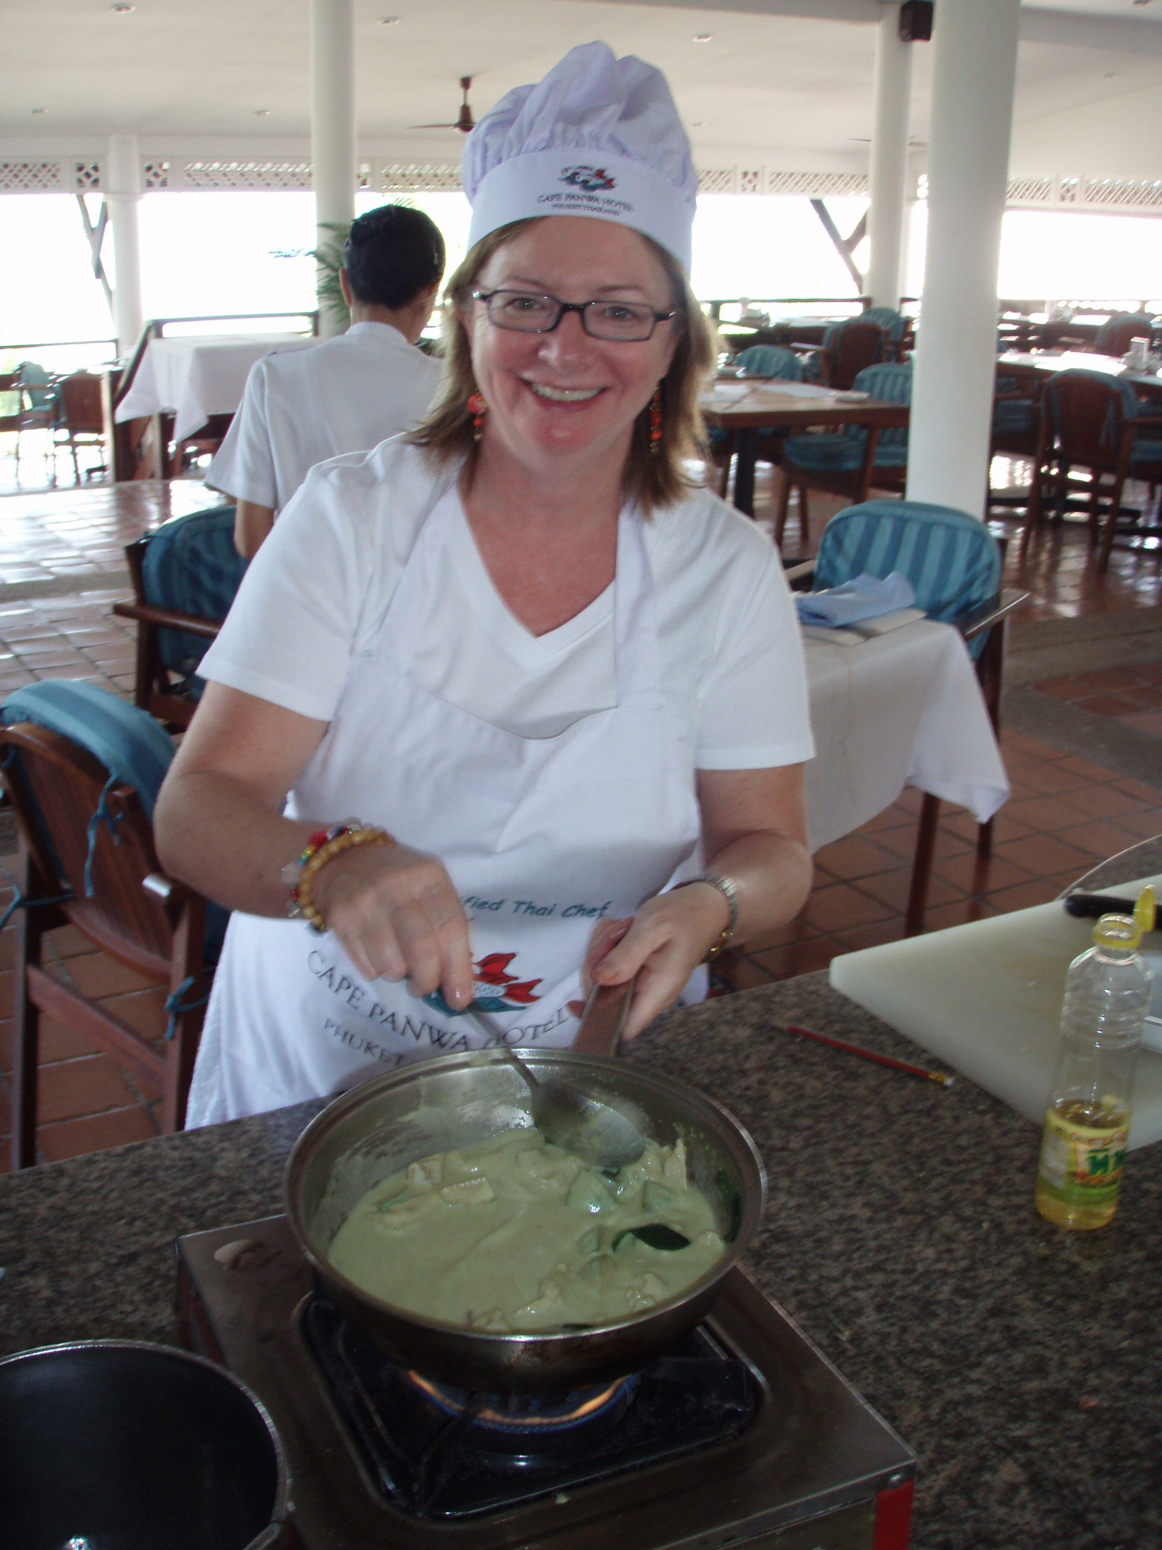
Cooking Classes in Thailand
(what am I cooking?)

Slide 18
An Example What do you think? … Are the teaching and learning activities appropriate to the intended outcomes?

Slide 19
Outcome-based Approach?? (1)
Teaching
& Learning
Read a cook
book/recipe
Listen to a lecture on how to cook a Thai curry
Watch simulation of cooking Thai curry
Assessment
Multiple choice
test
Intended outcome
Be able to cook a Thai curry dish and adaptations thereof
Content
Information on:
Ingredients
Utensils
Time to prepare
(Is the planned curriculum aligned?)

Slide 20
Outcome-based Approach (2)
Intended outcome
Be able to cook a Thai curry dish and adaptations thereof
Content
Information on:
Ingredients
Utensils
Time to prepare
Teaching
& Learning
Read a cook
book/recipe
See live demo and have opportunity to apply and practice
Assessment
Is the planned curriculum aligned? Suggestions for further improvement?

Slide 21
Levels of Complexity
Remembering
Understanding
Applying
Analyzing
Evaluating
Creating
Refer to handout ‘Levels of Complexity’
What will you ask your students to demonstrate?

Slide 22
Your Example
Subject Description?
Learning Outcomes?
Teaching and Learning Activities?
Assessment?
Activity/handout

Slide 23
For your course
Learning outcomes | Assessment tasks
1.
2.
3.

Slide 24
Assessment Terminology
P 16-18

Slide 25
Assessment Plan for Your Course
How much and when?
Feedback to learning in progress ???
Lab work/quizzes/ ?????
Mid term tests???
Other ????
Final Exam
TOTAL
%
%
%
70%
100%
IS this the only model??????

Slide 26
Characteristics of a ‘Good’ Evaluation Plan
Page 18

Slide 27
Your Plan
Design/review the evaluation plan for your course.
Refer to checklist.

Slide 28
Test Construction
P 20

Slide 29
References on Assessment
Angelo, T. & Cross, P. (1990). Classroom Assessment Techniques. New York: Jossey-Bass.
Boud, D. (1986). Implementing Student Self- Assessment. Sydney: Higher Education Research and Development Society of Australia.
Boud, D. (2000). Sustainable assessment: rethinking assessment for the learning society. Studies in Continuing Education. 22 (2), 151-167.
Yorke, M. (2003). Formative assessment in higher education: Moves towards theory and the enhancement of pedagogic practice. Higher Education, 45 (4), 477-501.

Slide 30
Additional Questions/Discussion

Slide 31
Assessment Session 2: Using Rubrics
August, 2014
Diane Salter, Vice Provost Teaching and Learning

Slide 32
Goals for this session
Discuss rationale for use of Rubrics
Critique evaluation Rubrics
Design an evaluation Rubrics for one of your assignments

Slide 33
Rubrics are tools for developing and grading assessments
Why Use Rubrics?

Slide 34
Rubrics are tools for developing and grading assessments
Why Use Rubrics?
Keep grading consistent
Save time
Promote student learning
Convey feedback
Help students understand what is expected
Help students understand their grade

Slide 35
Student Presentation
How do you assign grades to a student presentation?

Slide 36
What mark out of 10 would you assign? http://www.youtube.com/watch?v=KYtm8uEo5vU

Slide 37
What criteria did you use to assess?
(What does ‘good’ look like?)

Slide 38

Rubric for Scoring The Speech

Slide 39
SOLO Taxonomy
Review ‘Assessing Student Responses’
Review Rubric for marking an essay

Slide 40
Review examples of Rubrics
Review Example A and B.

Slide 41
Assess The Examples
Is one better than the other?
What could be improved?
Nothing
Too few traits
Too many traits
Too few levels
Too many levels
Criteria are explicit and understandable

Slide 42
A Three Level Rubric
Dimensions | Exemplary | Competent | Developing
The things that you are looking for
Content
Presentation
Analysis

Slide 43
A Three Level Rubric
Dimensions | Exemplary | Competent | Developing
Knowledge and Understanding 30% 0-30 points
Thinking/Inquiry 30% 0-30 points
Grammar/Writing 20% 0-20 points
Creativity/Innovation 20% 0-20 points

Slide 44
A Three Level Rubric
Dimensions | Exemplary Do this first 1 | Competent Then do this one last 3 | Developing Do this next 2
Knowledge and Understanding
Thinking/Inquiry
Grammar/Writing
Creativity/Innovation

Slide 45
Design A Three Level Rubric
Dimensions Traits you expect | Exemplary Do this first | Competent Then do this one last | Developing Do this next
Select an assignment/assessment you might grade this semester

Slide 46
Resources
The Effects of Instructional Rubrics on Learning to Write
http://cie.asu.edu/volume4/number4/
Scoring rubrics: what, when and how?
Scoring rubrics: what, when and how?. Moskal, Barbara M.
Create Your Own Rubrics Online
RubiStar http://rubistar.4teachers.org/index.php
Rubrics Generator (free)
http://www.teach-nology.com/web_tools/rubrics/
Rubrics for the University Learning Outcomes
http://folios.bgsu.edu/assessment/Rubrics.htm
CTE web site
http://cte.umd.edu/teaching/workshopseries_Spr05.htm
Google Rubrics
3,350,000 hits for rubrics

Slide 47
Additional Questions/Discussion

